Slide 1
Data Warehouse
and Data Mining
UNIT - 2
Department: CSE (AI) Semester: 6TH

Slide 2
Unit 2 (SYLLABUS)
Dimensional Modelling: Defining the business requirements: Dimensional analysis,
Information packages – a new concept, requirements gathering methods,
Requirements definition: scope and content. Principles of Dimensional Modelling: Objectives,
From Requirements to data design, Multidimensional Data Model,
Schemas: the STAR schema, the Snowflake schema, fact constellation schema

Slide 3
By the end of UNIT–2, you should be able to:
Understand business requirements
Identify facts and dimensions
Organize requirements systematically
Convert requirements into a multidimensional model
Choose the right schema (STAR / Snowflake / Fact Constellation)

Slide 4
1. Problem Statement
A college wants to analyze:
Subject-wise student performance
Year-wise pass & fail trend
Department-wise results
But data is stored in:
Student Registration System
Examination System
Marks Entry Tables
❓ Question: Can we directly use this data for analysis efficiently?
2. Issues with Existing Systems
Data is spread across multiple tables
Tables are designed for daily operations
Complex SQL queries required
Slow performance for reports
Difficult for management to understand
❌ Not suitable for analysis
3. What Management Actually Wants
Easy-to-understand reports
Fast answers to questions like:
“Which subject has highest failure?”
“How are results changing year-wise?”
Simple analysis without complex queries
✅ This leads to Dimensional Modelling

Slide 5
What is Dimensional Modelling?
Dimensional Modelling is a data design technique used in data warehouses to organize data for easy analysis and reporting.
Core Idea of Dimensional Modelling
Two Main Components
FACT → What we measure
DIMENSION → How we analyze
Example (College Case)
Fact: Marks obtained
Dimensions: Student, Subject, Time, Department

Slide 6
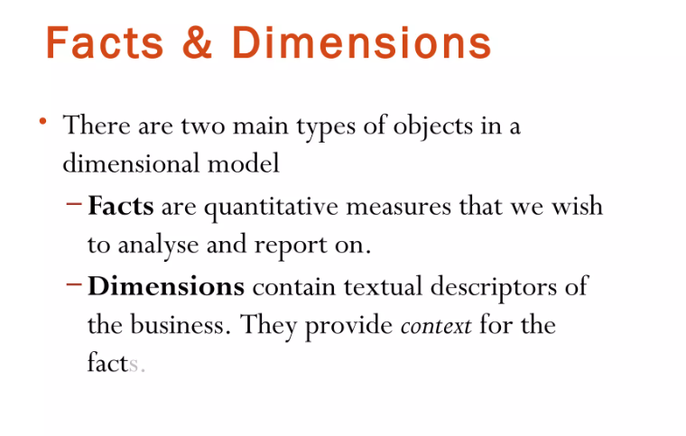

Slide 7
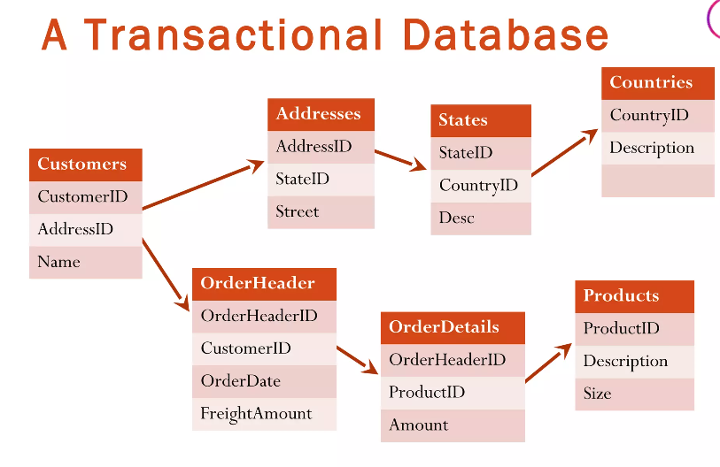

Slide 8
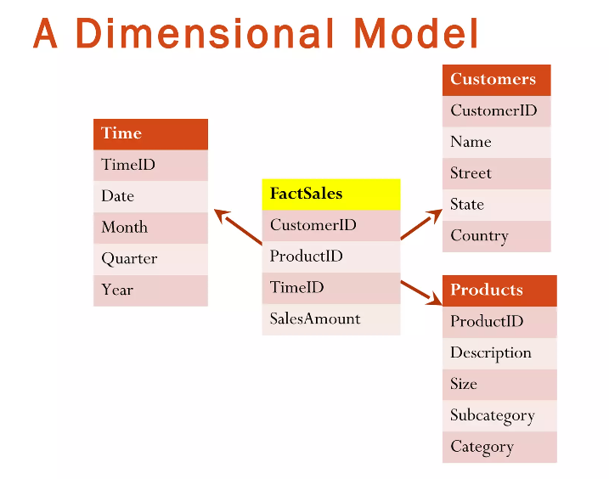

Slide 9
Point | Transactional Database | Dimensional Model
Purpose | Daily operations | Analysis & reporting
Design | Many small tables | Few big tables
Joins | Many joins | Very few joins
Speed for analysis | Slow | Fast
Users | Clerks, operators | Managers, analysts

Slide 10
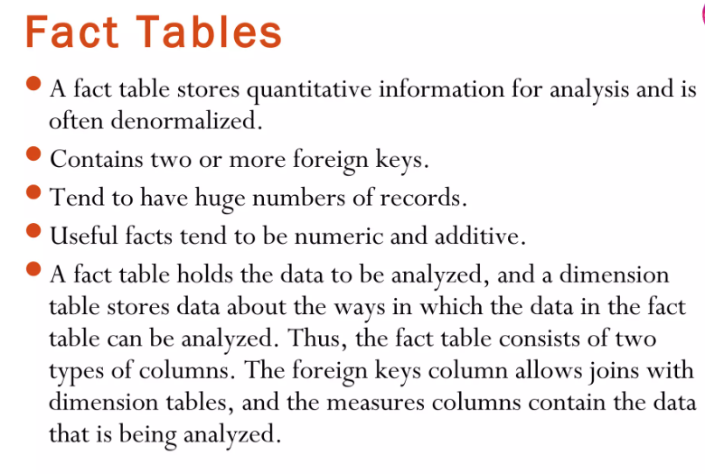

Slide 11
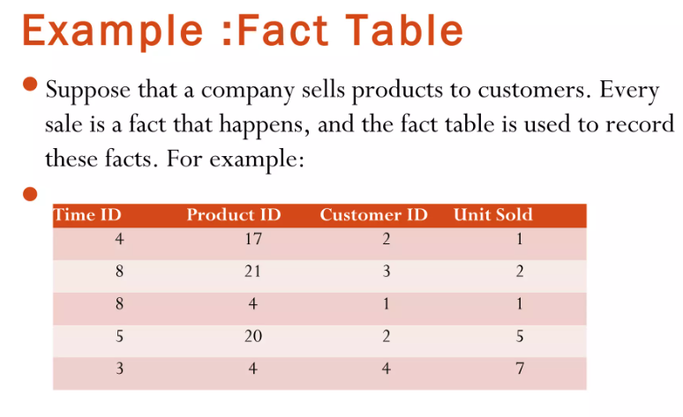

Slide 12
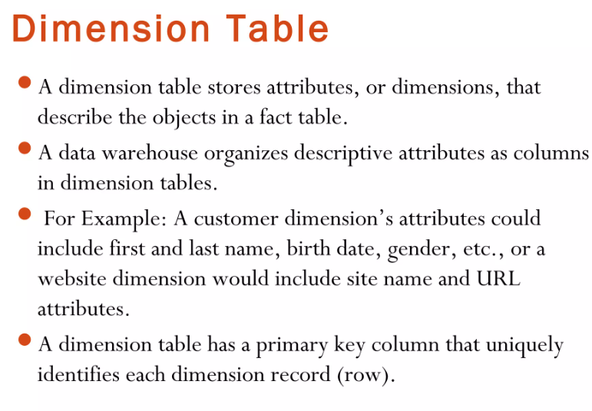

Slide 13
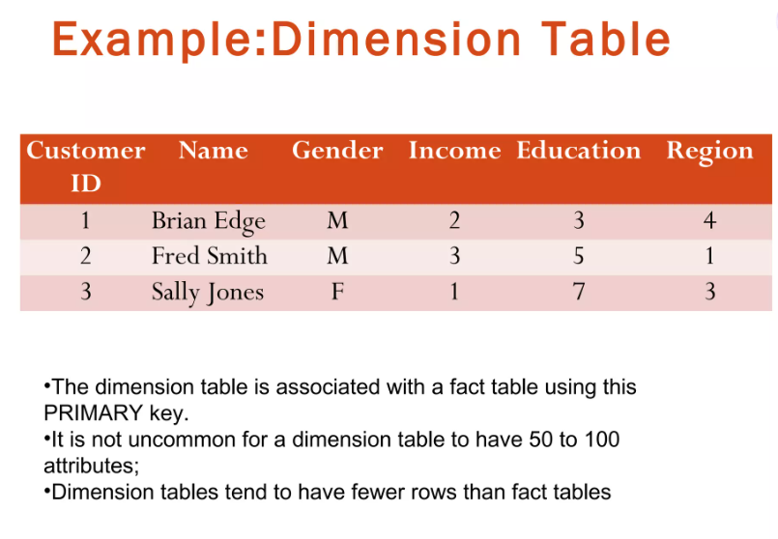

Slide 14
Dimension Table 1: Time Dimension
The Time Dimension helps us analyze sales based on date, month, quarter, or year. Instead of storing full date details in the fact table, we store only Time ID.
📋 Dim_Time Table
Time ID (PK) | Date | Day | Month | Quarter | Year
3 | 12-03-2024 | Tuesday | March | Q1 | 2024
4 | 15-04-2024 | Monday | April | Q2 | 2024
5 | 18-05-2024 | Saturday | May | Q2 | 2024
8 | 10-08-2024 | Saturday | August | Q3 | 2024
Explanation
Time ID is the primary key.
It connects to the fact table.
Enables queries like:
Sales per year
Sales per month
Quarterly performance

Slide 15
Why Dimensional Modelling is Used?
1. Easy to Understand
Dimensional modelling uses a simple structure with fact and dimension tables. This makes the data easy to understand even for non-technical business users.
2. Faster Query Performance
It requires fewer table joins compared to normalized databases. As a result, analytical queries execute faster and more efficiently.
3. Supports Business Analysis
Data is organized in a way that allows analysis from multiple perspectives. Users can easily analyze data by time, product, customer, or location.
4. Designed for Decision Making
Dimensional models are built specifically for reporting and analysis. They help management make accurate and data-driven business decisions.

Slide 16
Business Requirement
A business requirement is a clear statement that describes what a business needs to achieve, analyze, or decide in order to support its goals and decision-making processes.
In the context of data warehousing and dimensional modelling:
Business requirements define the type of information, analysis, and reports that decision makers need from data.
Benefits of Understanding Business Requirements
Correct fact tables are identified
Relevant dimensions are selected
Unnecessary data is avoided
Reports are accurate and fast
Better support for decision making

Slide 17
Example: Retail Sales Company
A retail company wants to improve its sales performance.
Business (Managers) Ask:
What is the total sales per month?
Which product categories generate the highest revenue?
Which regions have low sales?
Who are the top 10 customers by sales?
👉 These questions are business requirements, because they describe:
What analysis is needed
What decisions must be supported

Slide 18
Based on the above business requirements:
Identified Facts:
Sales Amount
Quantity Sold
Identified Dimensions:
Time (Day, Month, Year)
Product (Category, Subcategory)
Customer (Name, Region)
Store / Region
📌 This shows how business requirements are converted into fact and dimension tables.
Example
Business requirement:
“Quarter-wise sales analysis”
Design mistake:
Time dimension not included in the data model
❌ Result:
Required report cannot be generated
✔ Correct approach:
Understand business needs
Then design fact and dimension tables

Slide 19
Dimensional Analysis
Dimensional analysis is a systematic approach used in data warehousing to understand business activities and convert them into a dimensional data model.
It helps in identifying what data to store and how it should be analyzed for decision making.
Dimensional analysis is the process of breaking down a business problem into:
Business processes
Measures (facts)
Dimensions
The goal of dimensional analysis is to clearly understand what happens in the business, what needs to be measured, and from which perspectives the data should be analyzed.

Slide 20
Hospital Management Process
In a hospital:
Business process: Patient treatment
Measures (facts): Treatment cost, number of days admitted
Dimensions: Patient, Doctor, Time, Department
This helps management evaluate hospital performance and resource utilization.
Sales Business Process
Consider a retail store where products are sold to customers.
Business process: Sales
Measures (facts): Sales amount, quantity sold
Dimensions: Time, Product, Customer, Store
This structure allows the business to analyze sales by month, by product category, or by customer.

Slide 22
Imagine a college principal asking these questions:
“How many students passed this year?”, “Which department has the best results?”, “Which subject has the highest failure rate?”
Now imagine the IT team directly starts creating tables without clearly understanding these questions.
The result will be wrong tables, missing data, and useless reports.
👉 To avoid this confusion, we first need a structured way to understand what information the business really wants.
This is where the concept of Information Package comes in.

Slide 23
What is an Information Package?
An Information Package is a conceptual representation of business requirements used in data warehousing.
It describes what needs to be analyzed, from which perspectives, and using which measurements, before any database design begins.
It focuses on business understanding, not on tables or schemas.
In simple words, an information package answers the question: “What information does the decision-maker want?”
It acts as a bridge between business users and data warehouse designers.

Slide 24
Why Information Package is Needed
In traditional systems, data is stored for day-to-day operations, not for analysis.
However, decision-making requires:
Summarized data
Historical trends
Multiple perspectives
The information package helps:
Capture business needs clearly
Identify facts and dimensions correctly
Avoid unnecessary or missing data
Thus, it ensures that the final data warehouse supports analysis and decision making, not just data storage.

Slide 25
Components of an Information Package – Overview
An information package is built using four core
components:
Business Process
Measures
Dimensions
Attributes
Each component plays a specific role in defining what to analyze and how to analyze it.

Slide 26
Business Process
A business process represents the main activity of the organization that needs to be analyzed.
It answers the question: “Which activity are we analyzing?”
Examples of business processes:
Sales in a retail company
Student performance in a university
Patient treatment in a hospital
For example, in a sales system, the business process is selling products to customers.
All analysis will revolve around this process.
Measures (Facts)
Measures are quantitative values that represent what is being measured in the business process.
They are usually numeric and used for calculations and analysis.
Measures answer questions like:
How much?
How many?
What is the total or average?
Examples:
Sales amount
Units sold
Marks obtained
Treatment cost
In a sales system, sales amount and quantity sold are typical measures.

Slide 27
Dimensions
Dimensions represent the perspectives or angles from which the business wants to analyze the measures.
They answer questions like:
By whom?
When?
Where?
What type?
Common dimensions include:
Time
Customer
Product
Department
For example, sales can be analyzed:
By year (Time dimension)
By product (Product dimension)
By customer (Customer dimension)
Attributes
Attributes are descriptive properties of dimensions.
They provide more detail about each dimension.
For example:
Time dimension → year, month, quarter
Student dimension → name, gender, department
Product dimension → category, brand, size
Attributes help users filter, group, and drill down data during analysis.

Slide 28
Information Package vs ER Model
An Information Package focuses on:
Business questions
Analysis requirements
Decision support
An ER Model focuses on:
Data storage
Relationships between entities
Operational systems
Information packages are analysis-oriented, while ER models are transaction-oriented.
That is why information packages are used before dimensional modelling, not ER models.

Slide 29
Example Information Package – Sales Analysis
Consider a Sales Analysis Information Package:
The business wants to analyze sales performance.
Business Process: Sales
Measures: Sales amount, units sold
Dimensions: Time, Product, Customer, Location
Attributes:
Time → year, month
Product → category, brand
Customer → city, gender
This information package later helps design:
One fact table (Sales)
Multiple dimension tables (Time, Product, Customer)

Slide 30
Requirements Gathering Methods
Requirements gathering is the process of collecting, understanding, and documenting user needs before designing an information package or data warehouse.
It helps analysts clearly identify what data is required, why it is required, and how it will be used.
Various methods are used to gather accurate and complete requirements, depending on the system, users, and business environment.

Slide 31
Interviews
Interviews involve direct discussion with users or stakeholders to understand their needs clearly. This method is useful when detailed and accurate information is required. The analyst can ask follow-up questions and clarify doubts immediately.
Example: In a university system, the analyst interviews the Dean and faculty members to understand what kind of performance reports they need. From interviews, the analyst learns that management wants student-wise results and subject-wise pass percentage.
Questionnaires
Questionnaires are a set of written questions distributed to many users at the same time. This method is useful when users are many and located at different places. It helps in collecting common requirements in a structured way.
Example: In a hospital system, questionnaires are given to doctors asking what reports they use frequently. Responses show that doctors need disease-wise patient count and monthly reports, which helps define analysis requirements.

Slide 32
Observation
Observation means the analyst watches users while they perform their daily work. This helps understand actual processes and identify requirements that users may not mention directly.
Example:
In a sales system, by observing sales staff, the analyst notices that sales are manually summarized every month. This reveals the need for automatic monthly and yearly sales analysis.
Existing Reports and Documents
Existing reports and documents show what information is already important to the organization. Studying them helps identify commonly used measures and dimensions.
Example: In a university, analyzing previous result sheets and academic reports helps identify requirements like semester-wise results, average marks, and year-wise performance trends.

Slide 33
Case Study Question
A university wants to improve academic decision-making. The management wants to analyze student performance over different years, subject-wise results, and department-wise trends. As a data analyst, you are asked to create an information package to support this analysis.
Solution: Information Package for University System
To support decision-making, an information package is created by clearly defining the business process, measures, dimensions, and attributes.
The business process in this case is Student Academic Performance Evaluation. This process focuses on analyzing how students perform in different subjects, semesters, and academic years.

Slide 34
The measures represent numerical values used for analysis. In the university system, important measures include marks obtained, total marks, pass/fail count, and average marks. These measures help management compare performance across time and departments.
The dimensions provide different perspectives for analyzing the measures. Common dimensions in this case are Student, Subject, Department, Semester, and Academic Year. Using these dimensions, performance can be analyzed student-wise, subject-wise, or year-wise.
Each dimension contains attributes that give more descriptive information. For example:
The Student dimension includes student ID, name, gender, and enrollment year.
The Subject dimension includes subject code, subject name, and credits.
The Time dimension includes semester and academic year.

Slide 35
Final Outcome
This information package helps the university answer important questions such as:
Which subjects have low pass percentages?
How is student performance changing year by year?
Which departments need academic improvement?
By structuring requirements using an information package, the university can design an effective data warehouse or decision support system.

Slide 36
Case Study
A retail company sells various products to customers across different cities and stores. Management wants to analyze sales performance to support decision making. They are interested in knowing total sales, number of units sold, and profit generated over time. They also want to analyze sales based on product category, customer type, and location.
Based on the above case study:
Identify the business process for analysis.
List the measures (facts) required for the sales system and explain why they are important.
Identify the dimensions used to analyze sales data.
For each dimension, list suitable attributes.
Draw a diagram-based Information Package for the Sales System.
Explain how this information package helps management in decision making

Slide 38
Requirements Definition – Introduction
Before creating a dimensional model, it is very important to clearly define the requirements.
Requirements definition means understanding what the business wants to analyze, what data is needed, and what data is not needed.
A well-defined requirement avoids confusion, reduces rework, and ensures the data warehouse supports correct business decisions.
Example Context:
We consider a Retail Sales System where management wants to analyze sales performance.

Slide 39
Defining Scope – What is Included?
Defining scope means deciding what business areas and analysis are part of the data warehouse.
In a sales system, included scope may cover:
Sales transactions
Products sold
Customers
Time period (daily, monthly, yearly)
Store or region-wise sales
Example: The scope includes analyzing:
Total sales per month
Product-wise and region-wise sales
Customer purchase behavior
This ensures the model focuses only on decision-support needs.
Defining Scope – What is Excluded?
Equally important is defining what is NOT included in the system.
This helps avoid unnecessary data and complexity.
In a sales system, excluded scope may include:
Employee salary details
Supplier payment processing
Inventory reorder operations
Example:
Although inventory exists, the current requirement is sales analysis only, so inventory management is excluded.

Slide 40
Defining Content – Facts to be Stored
Facts are numeric values that the business wants to measure and analyze.
In a sales system, common facts include:
Sales amount
Units sold
Discount amount
Profit
Example:
Each sales transaction stores:
Quantity sold = 3
Sales amount = ₹1500
These facts help management evaluate business performance.
Defining Content – Dimensions Required
Dimensions provide context to analyze facts. They answer questions like when, where, what, and by whom.
In a sales system, key dimensions are:
Time (date, month, year)
Product (name, category, brand)
Customer (type, city)
Store / Location (city, region)
Example:
Sales amount can be analyzed:
By year
By product category
By customer location

Slide 41
Principles of Dimensional Modelling – Introduction
Dimensional modelling follows certain principles to make data warehouses useful for analysis and decision making.
The main objective is not only to store data, but to make data easy to understand, fast to query, and flexible for future needs.
These principles guide how fact tables and dimension tables are designed.
Dimensional modelling aims to:
Keep the data model simple and user-friendly
Provide fast query performance
Support meaningful business analysis
Allow easy extension and future growth

Slide 42
1. Easy to Understand
One of the most important objectives of dimensional modelling is simplicity.
The data model is designed in such a way that business users can understand it easily, even if they are not technical experts.
In a star schema, facts are placed at the center and dimensions are placed around them.
This structure closely matches how users think about data, such as sales by product, by time, by region.
Because of this simple structure, users can write queries and analyze data without confusion.

Slide 43
2. High Query Performance
Dimensional models are optimized for fast query execution, which is very important in analytical systems.
Since dimension tables are denormalized and joined directly to the fact table, the number of joins is reduced.
For example, to find total sales per year, the system only needs to join the sales fact table with the time dimension.
This makes queries faster compared to complex normalized schemas.
High performance allows quick report generation and better user experience.

Slide 44
3. Supports Business Analysis
Dimensional modelling is specially designed for analytical queries, not for transaction processing.
It allows users to easily perform operations like:
Comparing sales across time periods
Analyzing performance by product or region
Finding trends and patterns
Because data is organized around business processes, managers can easily answer questions like “Which product performed best this year?” or “Which region has low sales?”

Slide 45
4. Extensible and Scalable
Another key objective of dimensional modelling is flexibility.
The model can be easily extended when business requirements change.
New dimensions or new attributes can be added without disturbing existing data.
For example, if the business wants to analyze sales by promotion, a new promotion dimension can be added.
This scalability ensures that the data warehouse can grow with the business over time.

Slide 47
Granularity – Introduction
Granularity is a fundamental concept in dimensional modelling.
Before designing fact tables and dimensions, we must clearly decide how detailed the data should be stored.
The level of detail chosen directly affects storage size, query flexibility, and business analysis capabilities.
Granularity (or grain) refers to the level of detail represented by a single row in a fact table.
It answers the question: “Exactly what does one record in the fact table represent?”
For example:
One row can represent one product sold in one transaction
Or one row can represent total sales for one day
Once the grain is defined, all facts and dimensions must follow the same level of detail.

Slide 48
Consider a sales system:
If one row stores each individual item sold, the data is very detailed.
If one row stores total sales per day, the data is less detailed.
Both are valid designs, but the analysis possibilities differ.
Choosing the correct grain is a business decision, not just a technical one.

Slide 49
Importance of Choosing the Correct Grain
Choosing the correct granularity is critical because it affects:
Business Analysis Capability Fine-grain data allows deeper analysis such as customer behavior and product-level trends.
Query Flexibility Detailed data can be aggregated later, but aggregated data cannot be broken down further.
Storage and Performance Fine-grain data requires more storage, while coarse-grain data needs less space and faster queries.
Future Requirements If future analysis needs more detail, coarse-grain data may not be sufficient.

Slide 50
Fine-Grain Data – Meaning
Fine-grain data represents the lowest level of detail. Each row in the fact table captures a single business event.
Example:
One row = one product sold
One row = one student’s marks in one subject
One row = one hospital visit by a patient
Fine-grain data provides maximum analytical flexibility.
This design allows analysis like:
Sales per customer
Sales per product
Hourly or daily trends
Fact Table: Sales_Fact (Fine-Grain)
Each row represents one product sold in one transaction.
Date | Product | Customer | Store | Quantity | Amount
01-Jan | Laptop | C101 | S1 | 1 | 50,000

Slide 51
Coarse-Grain Data – Meaning
Coarse-grain data represents summarized or aggregated information.
Each row represents data at a higher level, such as per day, per month, or per region.
This approach reduces data volume but limits detailed analysis.
This design supports:
Daily sales reports
Monthly or yearly trends
But it cannot answer questions like:
Which customer bought what?
Which product sold the most?
Fact Table: Daily_Sales_Fact (Coarse-Grain)
Each row represents total sales for one day.
Date | Total_Quantity | Total_Amount
01-Jan | 120 | 18,00,000

Slide 52
Fine-Grain vs Coarse-Grain Comparison
Aspect | Fine-Grain Data | Coarse-Grain Data
Level of detail | Very high | Low
Storage | Large | Small
Query flexibility | High | Limited
Future analysis | Possible | Restricted
Example | One sale per row | One day per row

Slide 53
When to Choose Which Grain in Dimensional Modelling
Choosing the grain means deciding how detailed each row in the fact table should be.
The correct grain depends mainly on business requirements, not technology.

Slide 54
1. Choose Fine-Grain (Detailed Grain) When…
Fine-grain data stores each individual business event.
Choose fine-grain if:
Business users want detailed analysis
Future questions are not fully known
Drill-down analysis is required
Individual transactions matter
Typical Scenarios:
Sales system → one row per product per transaction
Student system → one row per student per subject per exam
Hospital system → one row per patient visit
Example:
A retail manager asks:
“Which customer bought which product on which date?”
This requires fine-grain data, because each sale must be stored separately.
✅ Rule: If users want maximum flexibility, always choose fine grain.

Slide 55
2. Choose Coarse-Grain (Aggregated Grain) When…
Coarse-grain data stores summarized information.
Choose coarse-grain if:
Only summary reports are required
No need for detailed drill-down
Data volume must be minimized
Performance is more important than detail
Typical Scenarios:
Daily sales totals
Monthly revenue reports
Yearly patient counts
Example:
A CEO asks:
“What is the total sales per month?”
Here, monthly-level data is sufficient. Transaction-level details are unnecessary.
⚠️ Limitation: Once data is aggregated, detail cannot be recovered later.

Slide 56
Choosing Grain Based on Business Questions
Always decide grain by asking:
What questions will users ask?
What level of detail do they need?
Will future users need deeper analysis?
Example:
If today’s question is:
“Total sales per year”
But tomorrow’s question may be:
“Which product category performed poorly in March?”
➡️ Fine-grain is safer for future needs.
Golden Rule of Grain Selection
Store data at the lowest possible level of detail that the business can support.
Why?
Aggregation can be done later
Detail cannot be added later

Slide 58
Multidimensional Data Model
Problem with Traditional (Transactional) Data
In traditional databases (OLTP systems), data is stored in many normalized tables.
While this structure is good for daily operations, it creates problems for analysis.
Example problem:
To find total sales by year and product, we must join many tables
Queries become complex and slow
Business users find reports difficult to understand
As a result, decision-making becomes time-consuming.

Slide 59
Need for a Better Analytical Model
Business users need:
Simple structure
Fast query results
Easy analysis across multiple perspectives (time, product, region, etc.)
This requirement leads to the Multidimensional Data Model.
What is a Multidimensional Data Model?
A multidimensional data model organizes data in a way that allows it to be viewed from multiple dimensions.
It is based on:
Facts → numeric data to be analyzed
Dimensions → different ways to analyze the facts
The model represents data as a multidimensional space, instead of complex tables.

Slide 60
Multidimensional Data Representation
A multidimensional model typically uses:
Fact Table: Contains measures and foreign keys to dimensions.
Dimension Tables: Contain attributes that describe context for the facts.
Cube Representation: Organizes facts across multiple dimensions for faster aggregation and slicing.

Slide 61
Working on a Multidimensional Data Model
Building a multidimensional data model typically involves:
Identifying Business Requirements: Determine the key questions the business wants to analyze (e.g., sales trends, regional performance).
Defining Dimensions: Identify descriptive categories such as time, product, location, or customer that will provide context for analysis.
Defining Facts: Select measurable values such as sales, cost, or units sold that will be stored in the fact table.
Identifying Hierarchies: Establish natural roll-up paths (e.g., Year → Quarter → Month → Day).
Designing the Schema: Create a star or snowflake schema linking fact and dimension tables.
Building Data Cubes: Organize facts and dimensions into cube structures that support slicing, dicing, drill-down, roll-up, and fast aggregation.

Slide 62
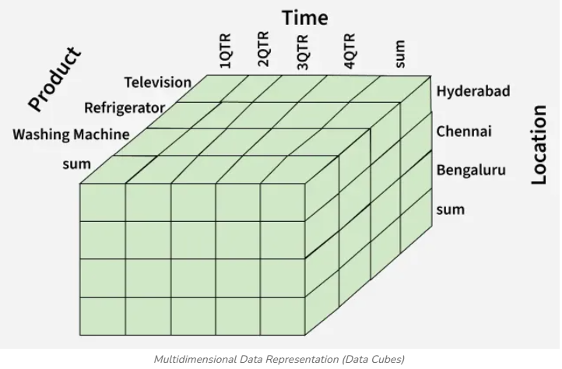
Concept of Multidimensional Space
In this model, data is visualized as a cube-like structure:
Each dimension represents one axis
Each cell in the cube stores a fact value
Example:
Dimensions: Time, Product, Customer
Fact: Sales Amount

Slide 63
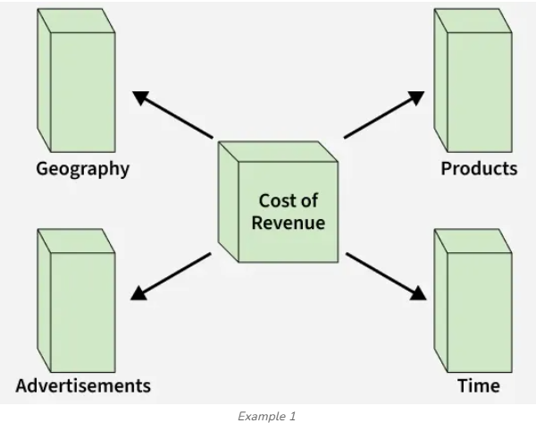
Example: Understanding the Multidimensional Model
1. Let us take the example of a firm. The revenue cost of a firm can be recognized on the basis of different factors such as geographical location of firm's workplace, products of the firm, advertisements done, time utilized to flourish a product, etc.

Slide 64
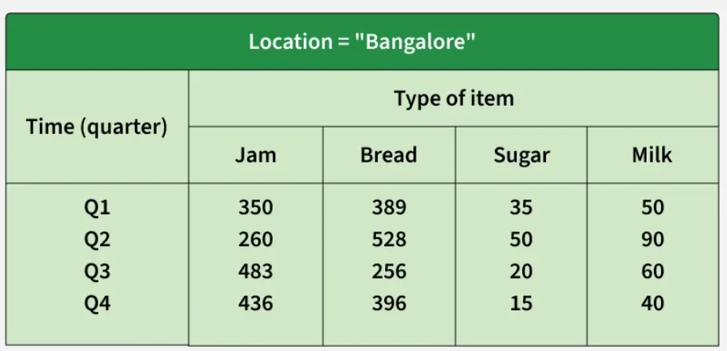
2. Let us take the example of the data of a factory which sells products per quarter in Bangalore. The data is represented in the table given below:
In the above given presentation, the factory's sales for Bangalore are, for the time dimension, which is organized into quarters and the dimension of items, which is sorted according to the kind of item which is sold. The facts here are represented in rupees (in thousands).

Slide 65
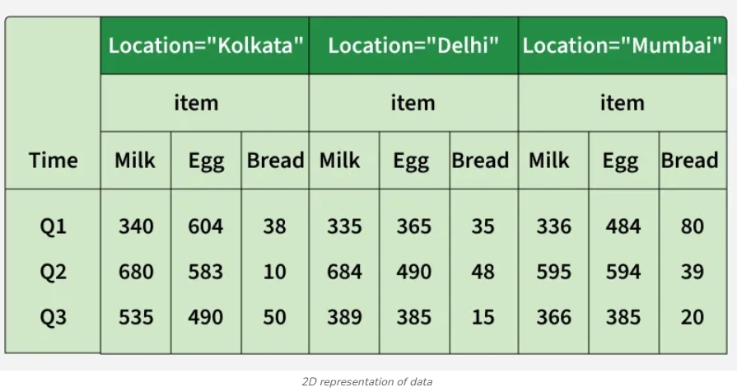
Suppose we need to add multiple cities (for e.g. Kolkata, Delhi, Mumbai) then the table can be extended as:

Slide 66
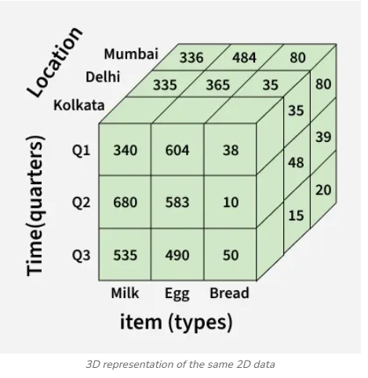
The same data above, can also be represented in the form of three dimensions as given below:

Slide 67
Benefits of Multidimensional Data Model
1. Easy to Understand
The multidimensional data model is designed in a way that matches how business users think. Data is organized into facts and dimensions, making it intuitive even for non-technical users to understand and use for analysis.
2. Faster Query Performance
Since data is stored in a simplified structure with fewer joins, analytical queries execute much faster. This is especially useful for large datasets where complex reporting is required.
3. Supports Business Analysis
The model allows data to be analyzed from multiple perspectives such as time, product, location, or customer. This makes it easy to perform comparisons, identify trends, and generate meaningful insights.

Slide 69
Schema in Dimensional Modelling
In simple terms, a schema is the logical structure or blueprint of how data is organized in a data warehouse.
It defines how fact tables and dimension tables are connected and how data will be stored and queried.
A schema represents:
What data is stored (facts and dimensions)
How tables are related
How analysis will be performed
In dimensional modelling, schemas are designed mainly to support fast querying and easy analysis, not transactional updates like OLTP systems.
👉 Real-life analogy: Just like a map shows how roads and places are connected, a schema shows how data tables are connected for analysis.

Slide 70
STAR Schema
Structure of Star Schema
The Star Schema is the simplest and most commonly used schema in dimensional modelling.
It consists of:
One central fact table
Multiple dimension tables directly connected to the fact table
The structure looks like a star, where:
The fact table is at the center
The dimension tables surround it
The fact table contains numerical measures (e.g., sales amount, quantity), while dimension tables contain descriptive information (e.g., time, product, customer).

Slide 71
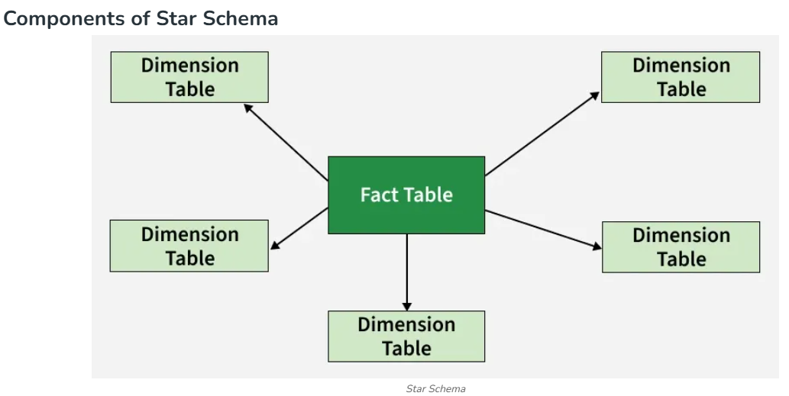

Slide 72
Characteristics of Star Schema
The Star Schema has a simple and intuitive design.
Each dimension table:
Is denormalized
Contains all related attributes in a single table
Has a primary key that connects to the fact table
Because dimensions are not split into multiple tables, the schema is:
Easy to understand
Easy to query
Business-friendly

Slide 73
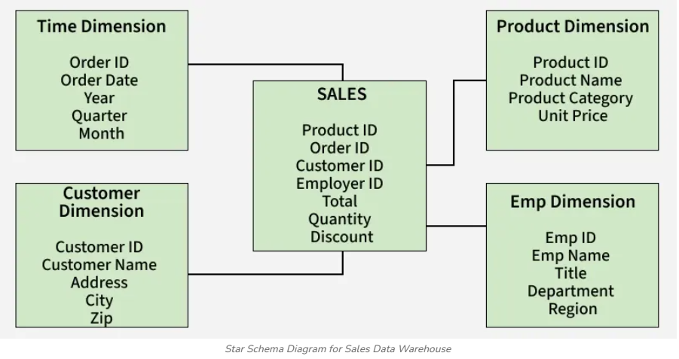
Star Schema Example (Sales Data Warehouse)
To demonstrate how a star schema works, consider a Sales Data Warehouse where each sales transaction is stored in a central fact table and is analyzed through surrounding dimension tables. This model supports fast, flexible analysis across products, customers, time, and employees.

Slide 74
SALES fact table stores numerical measures such as total amount, quantity, and discount, along with foreign keys to each dimension.
Surrounding dimension tables provide descriptive attributes that allow the facts to be examined from different perspectives.
Product Dimension describes what was sold and the Customer Dimension identifies who purchased it.
Time Dimension indicates when the transaction occurred, and the Employee Dimension specifies who processed the sale.

Slide 75
Advantages of Star Schema
The Star Schema is widely preferred because:
It provides high query performance due to fewer joins
It is easy for users and analysts to understand
OLAP operations like slice, dice, drill-down, and roll-up are simpler
It is well-suited for reporting and dashboards
Disadvantages of Star Schema
Despite its simplicity, the Star Schema has some limitations:
Denormalized dimensions may cause data redundancy
Requires more storage space
Not ideal when dimensions are very large or complex

Slide 77
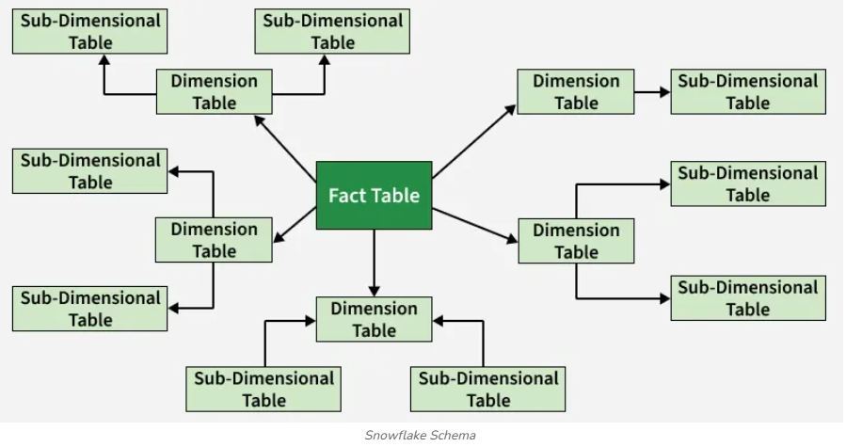
Snowflake Schema in Data Warehouse Model
A Snowflake Schema is a data warehouse modeling technique where dimension tables are normalized into multiple related sub-tables. It is an extension of the Star Schema, designed to handle complex hierarchies and reduce data redundancy. The snowflake effect applies only to dimension tables, not the fact table.

Slide 78
Dimension tables are normalized into multiple related tables, creating a hierarchical or "snowflake" structure.
Fact table is still located at the center of the schema, surrounded by the dimension tables. However, each dimension table is further broken down into multiple related tables, creating a hierarchical structure that resembles a snowflake
Features of the Snowflake Schema
Normalization: Snowflake schema uses normalized tables to reduce redundancy and improve consistency.
Hierarchical Structure: Built around a central fact table with connected dimension tables.
Multiple Levels: Dimensions can be split into multiple levels, allowing detailed drill-down analysis.
Joins: Requires more joins, which can slow performance on large datasets.
Scalability: Scales well for large data, but its complexity makes it harder to manage.

Slide 79
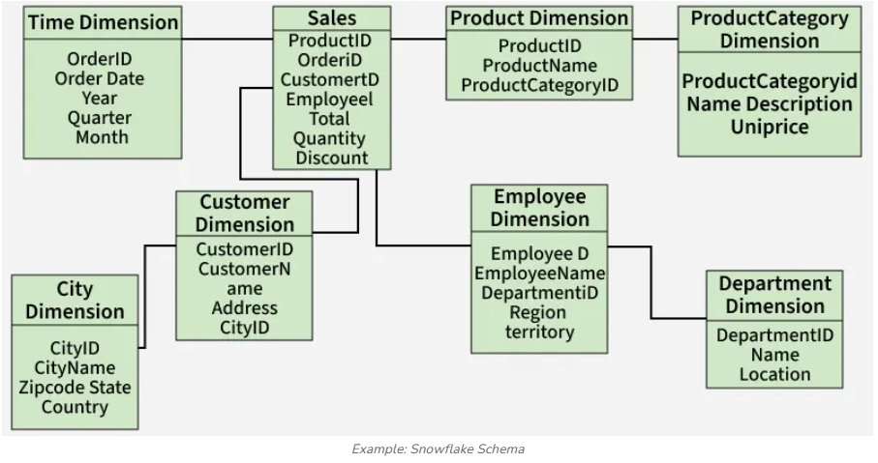
Example of Snowflake Schema
Below is a simplified representation of how a snowflake schema model looks

Slide 80
Employee dimension includes attributes like EmployeeID, Name, DepartmentID, Region, and Territory. DepartmentID links to the Department table, which holds department details like Name and Location.
Customer dimension includes CustomerID, Name, Address, and CityID. CityID links to the City table, which stores City Name, Zipcode, State, and Country.
Product dimension includes ProductID, ProductName, ProductCategoryID. ProductCategoryID links to the Product Category Dimension: Category Name, Description, Unit Price.
These hierarchical connections form the "snowflake" structure.

Slide 81
Characteristics of Snowflake Schema
Requires less storage because dimension data is structured.
Supports multiple hierarchies within a dimension.
Performance decreases because of extra joins.
Dimensions can be sourced from different systems and integrated cleanly.
Good when dimension tables contain attributes at different grains.

Slide 82
Advantages
Improves data integrity through normalization.
Reduces redundancy and storage usage.
Supports detailed hierarchical drill-down.
Disadvantages
Increased schema complexity.
More joins, leading to slower query performance.
Normalization may offer minimal storage savings compared to the entire warehouse.
Not recommended unless the hierarchy is essential and widely used in queries.

Slide 84
Fact Constellation Schema in Data Warehouse modelling
Fact Constellation in Data Warehouse modeling is a schema design that integrates multiple fact tables sharing common dimensions, often referred to as a "Galaxy schema." This approach allows businesses to conduct multi-dimensional analysis across complex datasets.
Fact Constellation Schema, also known as the Galaxy Schema, is an advanced data modeling technique used in designing data warehouses. Unlike simpler models like the Star Schema and Snowflake Schema, the Fact Constellation Schema consists of multiple fact tables that share common dimensional tables.
This model is ideal for handling complex systems and large-scale analytical queries, offering flexibility for business intelligence and data mining.
The core components of the Fact Constellation Schema include Fact Tables and Dimension Tables. Fact tables store measurable, quantitative data, such as sales or revenue, while dimension tables store descriptive attributes like time, location, or product. These tables are interconnected, with multiple fact tables sharing the same dimension tables.

Slide 85
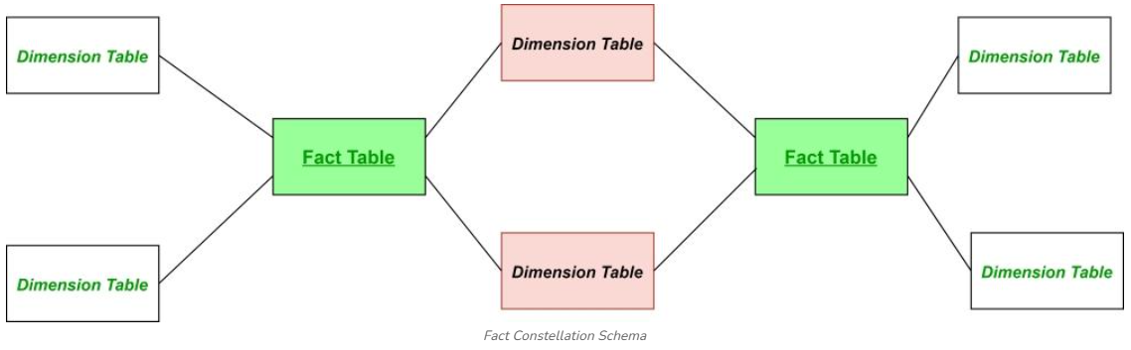
Here, the pink colored Dimension tables are the common ones among both the star schemas. Green colored fact tables are the fact tables of their respective star schemas.
In comparison to the Star Schema, which uses a single fact table and associated dimension tables, the Fact Constellation Schema is more complex and can handle various measures across multiple business areas. The Snowflake Schema is another variation where dimension tables are normalized. While the Snowflake Schema can be simpler to manage, the Fact Constellation Schema is better suited for organizations with more advanced data modeling needs, enabling sophisticated reporting and data analysis across multiple facts.

Slide 86
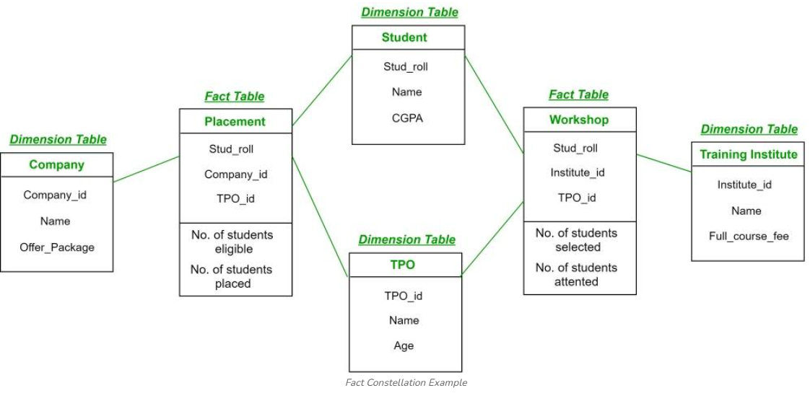
Example
In the diagram below, we have two fact tables: Placement and Workshop, each associated with their own star schemas. These star schemas share common dimension tables, forming the Fact Constellation schema, also referred to as the Galaxy Schema.

Slide 87
Fact Tables
Placement:
Attributes: (Stud_roll, Company_id, TPO_id)
Facts: (Number of students eligible, Number of students placed)
The Placement fact table records data related to student placements. It connects to the Company, Student, and TPO dimension tables.
Workshop:
Attributes: (Stud_roll, Institute_id, TPO_id)
Facts: (Number of students selected, Number of students attended)
The Workshop fact table captures information related to workshops attended by students. It is connected to the Student, TPO, and Training Institute dimension tables.

Slide 88
Dimension Tables
Company: Contains attributes like (Company_id, Name, Offer_package).
Student: Contains attributes like (Stud_roll, Name, CGPA).
TPO (Training and Placement Officer): Contains attributes like (TPO_id, Name, Age).
Training Institute: Contains attributes like (Institute_id, Name, Full_course_fee).
The Placement fact table connects to the Company, Student, and TPO dimension tables, forming a star schema. The Workshop fact table connects to the Student, TPO, and Training Institute dimension tables, forming another star schema. Both star schemas share the Student and TPO dimension tables, thus combining into a Fact Constellation Schema.
This structure allows for complex analysis across different aspects of the student data, such as placement and workshop participation, using shared dimensions. The fact tables (Placement and Workshop) represent different business processes, and by sharing common dimensions (like Student and TPO), this schema offers a powerful way to analyze and process data in a data warehouse.

Slide 89
Benefits of Fact Constellation
Enhanced Query Performance: Fact Constellation improves query performance by organizing multiple fact tables around shared dimensions, reducing query complexity and minimizing the need for large joins, thus speeding up data retrieval.
Flexibility in Reporting and Analysis: It offers flexibility in reporting by connecting multiple fact tables to common dimensions, allowing dynamic and customizable aggregation of data across different business metrics.
Improved Scalability: Fact Constellation efficiently handles large datasets by distributing data across fact tables and shared dimensions, ensuring scalability as data volumes grow.
Simplified Data Management: Its modular approach supports data partitioning, simplifying maintenance and optimizing storage, while allowing easy updates without disrupting the data model.
Enhanced Data Consistency: By sharing common dimensions, Fact Constellation ensures data consistency across the warehouse, reducing duplication and conflicts, which enhances reporting

